Slide 1
Group 1 Project 3 DATA ENGINEERING: creating a restaurant ratings database
Team: Cole O’Neill - Joel Fisher - Justin clawson - Selena Passeno – Zac Williams
Notes:
COLE

Slide 2







Tools used
Python/Jupyter Notebook
Pandas
Pprint
Requests
SqlAlchemy
SQLite
Urllib.parse
PostgreSQL
7zip
Leaflet
Notes:
COLE

Slide 3
Project overview
Collection of restaurant and ratings data from a variety of sources
Cleaning the data
Converting to dataframes, exporting to CSV
Loading to PostgreSQL
Using SQLite to pull data from PostgreSQL into dataframe
Notes:
COLE

Slide 4
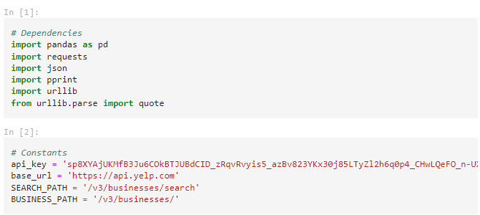
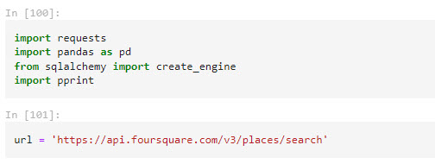
Data EXTRACTION
Sources: Yelp and Foursquare
Tried other sources but ran into issues
Downloaded TAR/JSON data as text into Excel and used the data toolbar to convert text to columns then performed line by line review due to junk data in over 30 columns
Used JSON to extract data for several cities
Notes:
JUSTIN

Slide 5
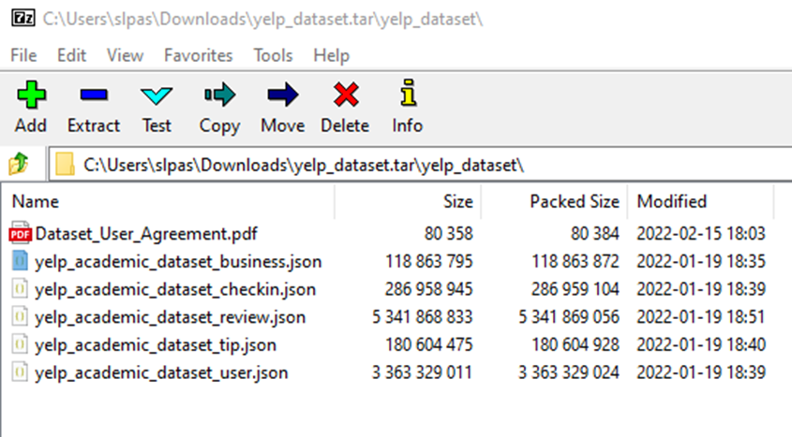
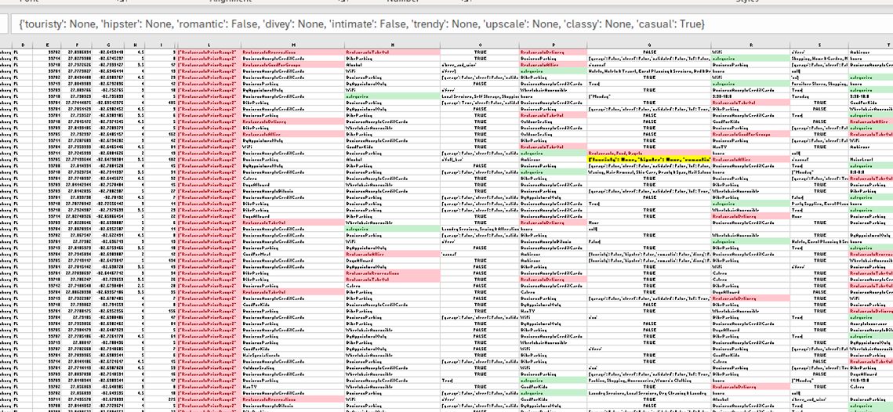

YELP CHALLENGE DATASET Transformation
Next Steps
Notes:
JUSTIN

Slide 6
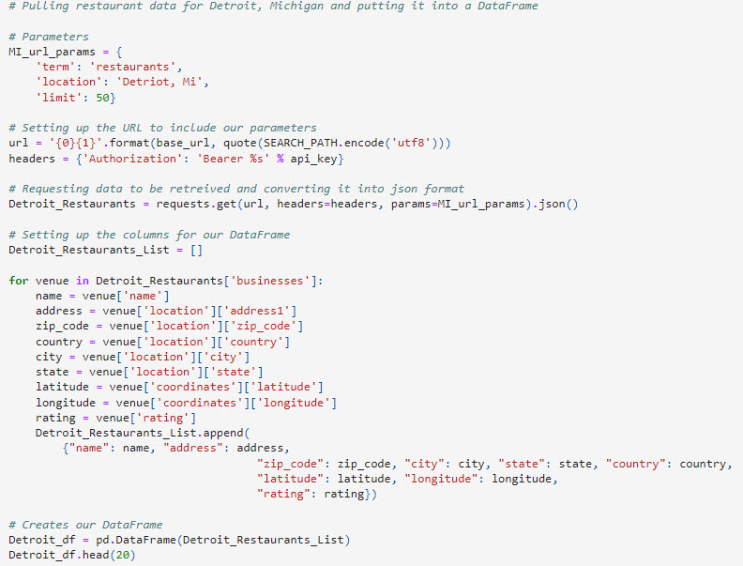
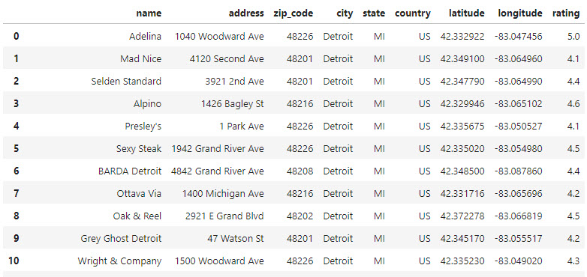
Data Transformation
Set parameters and removed unwanted fields, reformatted data types
Drop any null data
Ultimately whittled down to 317 items plus 291 items from new API calls
Notes:
ZAC

Slide 7
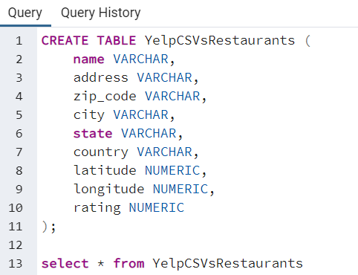
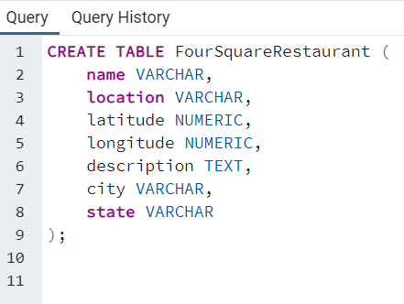
Data loading
Multiple data frames merged to one each for Yelp and Foursquare and exported to CSV
Notes:
ZAC

Slide 8
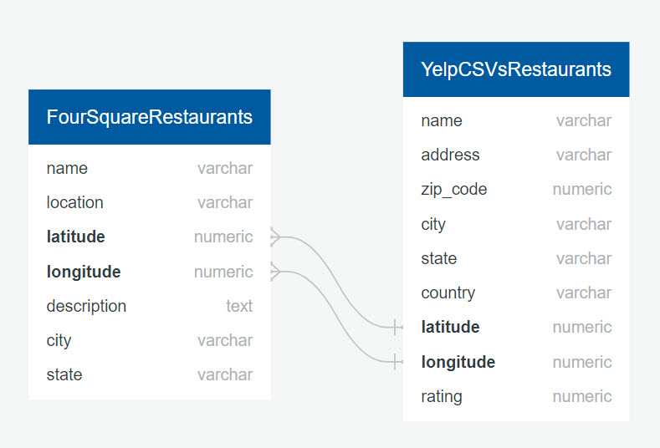
ERD DIAGRAM
Notes:
ZAC

Slide 9
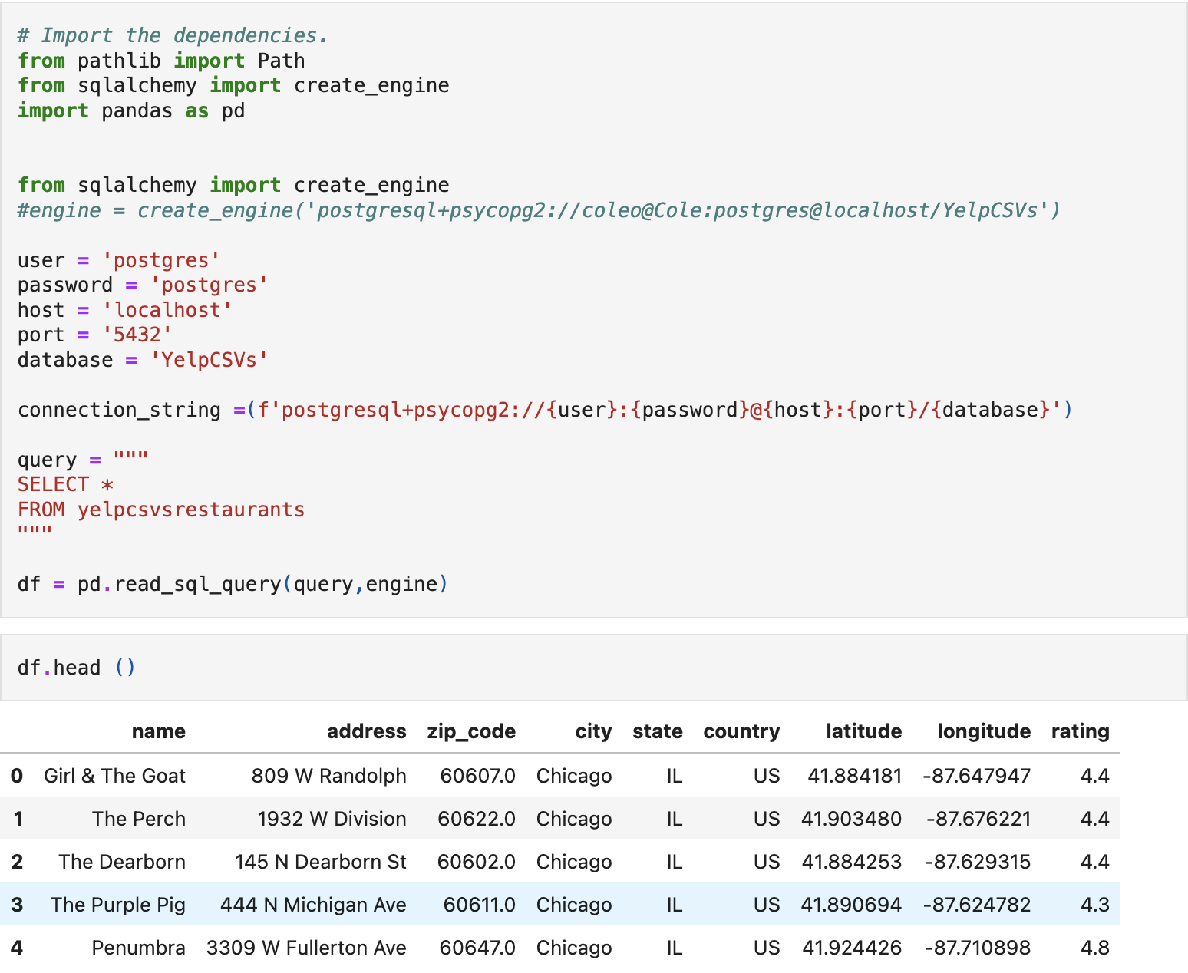
Loading sql database via sqlalchemy
Multiple dataframes merged to one each for Yelp and Foursquare and exported to CSV
Schemas allowed us to move the final database into a dataframe
Notes:
JOEL

Slide 10
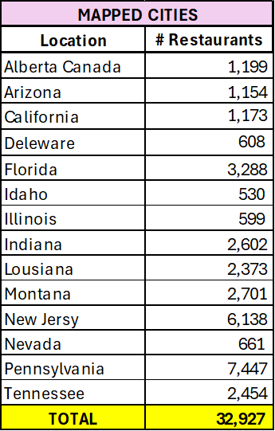
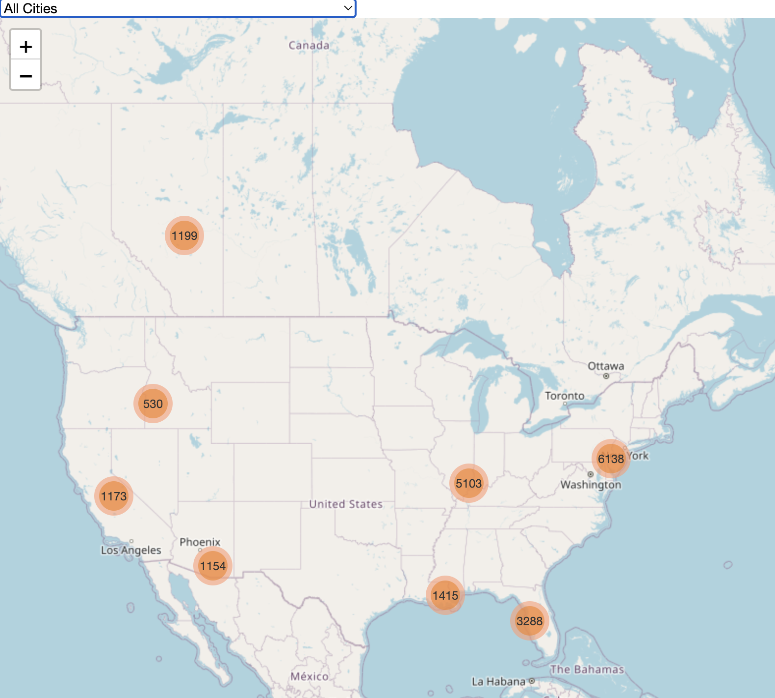
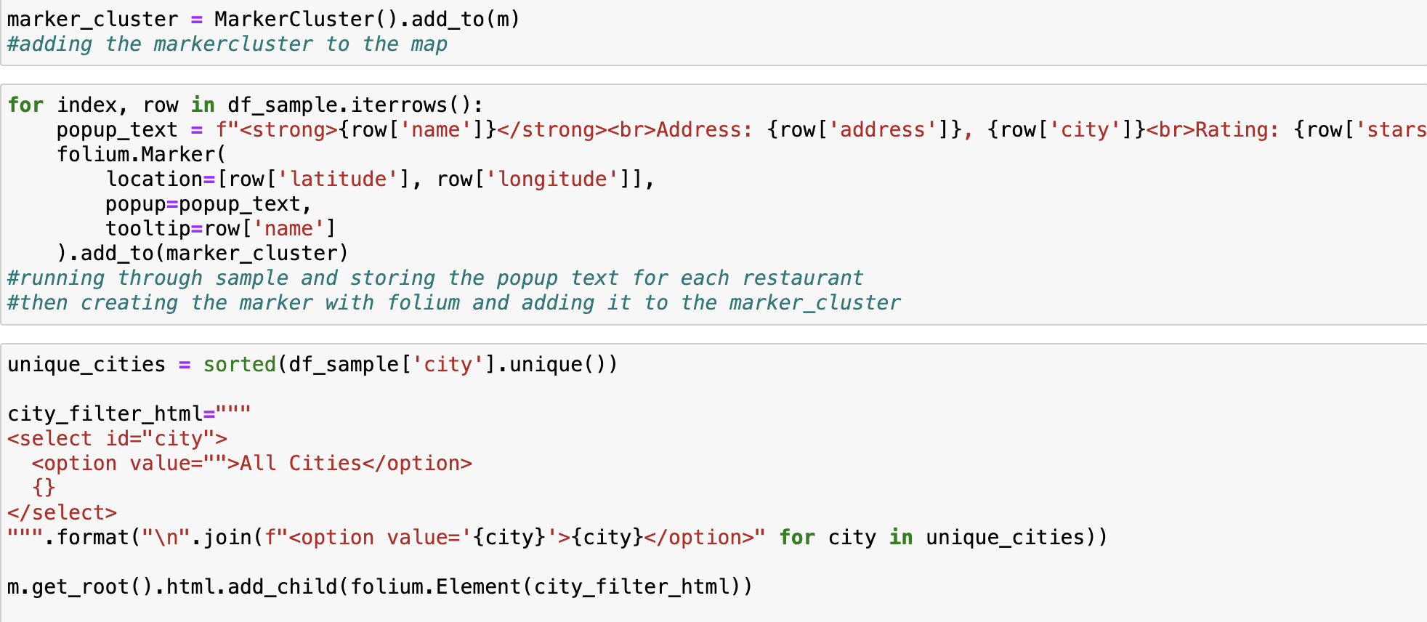
Folium/leaflet map
Notes:
JOEL

Slide 11
Ethical considerations
No ethical concerns identified, however some notes about how we handled the data –
Yelp academic dataset is a static file archived 1/19/2022, containing no PII
This dataset is not as current as information pulled by other team members using Foursquare and Yelp API calls
Removed any businesses with rating of less than 3 to reduce size of dataset
Notes:
SELENA

Slide 12
Challenges
Yelp dataset had erroneous attributes and categories creating trailing data that could not be loaded into programs resulting in heavy manual review
Data quality issues such as Home Depot being labeled a restaurant because you can buy hot dogs there
Large amounts of data, some intended sources either did not have public data or was behind a paywall
We ended up having to use some more recent data with some less recent data
Notes:
SELENA

